Slide 1

Healthcare Analytics For Doctor Visit TIRTC
Student Name : Snowlin Dhanusha A
College Name : Loyola-ICAM College of Engineering and Technology
AICTE STU ID : STU69eb655e5fc4a1777034590

Slide 2

PROBLEM STATEMENT
Some people visit a doctor many times, while most never visit at all. Healthcare providers need to know who visits doctors, how often, and why. Without this understanding, it is hard to plan capacity or to support the people with the greatest need.
"Why do some people visit a doctor more often than others?"

Slide 3
Project Description
Data: survey of 5,190 people with 12 variables and no missing values
Target: number of doctor visits in a 2-week period (0 to 9)
Factors studied:
Demographics: age, gender, income
Health status: illness count, reduced-activity days, health score
Chronic conditions: with and without activity limitation
Healthcare support: private insurance, free poor cover, free repatriation cover
Data preparation: removed the index column, checked nulls and duplicates (1,320 duplicates kept as valid survey responses)
Analysis: univariate, bivariate and multivariate exploration with charts, correlation analysis and a profile of high users (2 or more visits)
Goal: find the key drivers of doctor visits and the groups that need the most support

Slide 4

WHO ARE THE END USERS?
Hospitals and clinics
Health insurance companies
Government and public health agencies
Healthcare managers and planners
Care management teams
Researchers and students

Slide 5

Technology Used
Language: Python
Environment: Google Colab
Libraries:
  Pandas: loading, cleaning and grouping the data
  NumPy: numerical operations
  Matplotlib: creating charts
  Seaborn: statistical visualizations

Slide 6
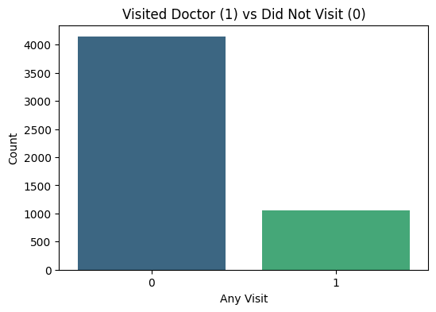
RESULTS
This chart compares people with no doctor visit against people with at least one.
4,141 people (79.8%) had no visit, while 1,049 people (20.2%) visited at least once.
Most people did not visit a doctor in the 2-week period.
Doctor visits are concentrated in a small group, so planning should focus on that group.

Slide 7

RESULTS
This chart shows how average visits change as the number of illnesses increases.
People with 0 illnesses average only 0.08 visits, while people with 5 illnesses average 0.81.
Visits rise steadily as illness increases, roughly a 10-fold jump.
This shows that health need is a major driver of doctor visits.

Slide 8
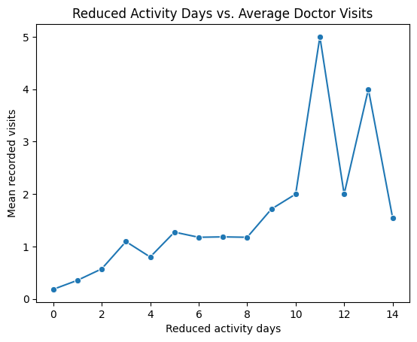
RESULTS
This chart compares days of reduced activity due to illness with average visits.
People with 0 reduced days average 0.18 visits, while those with 14 days average about 1.5.
It has the strongest correlation with visits (0.42) among all factors.
A few high points are noisy because very few people fall in those groups (for example, only 2 people at 11 days).

Slide 9
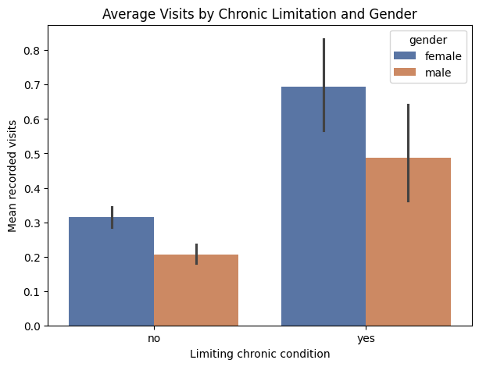
RESULTS
This chart compares visits for men and women, with and without a limiting chronic condition.
A limiting condition raises visits for women from 0.31 to 0.69 and for men from 0.21 to 0.49.
Women visit more than men in both groups.
Women with a limiting chronic condition are the highest-use group.

Slide 10
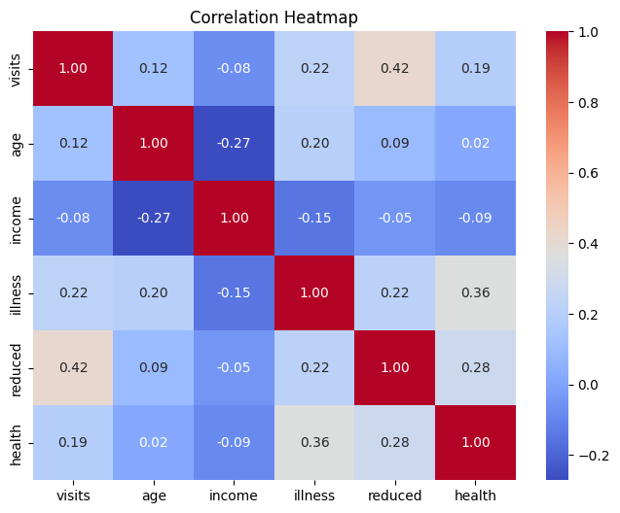
RESULTS
This chart shows how strongly each numeric factor is related to doctor visits.
Reduced-activity days (0.42), illness (0.22) and health score (0.19) have the strongest links.
Age has a weak positive link (0.12), and income has a weak negative link (-0.08).
Health condition matters more than demographics for predicting visits.

Slide 11
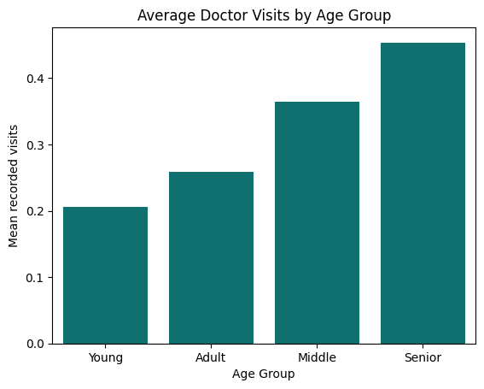
RESULTS
This chart compares average visits across four age groups.
Visits rise with age: Young 0.21, Adult 0.26, Middle 0.36 and Senior 0.45.
Seniors visit about 2.2 times as often as the young.
Older people need more attention, partly because they report more illness.

Slide 12
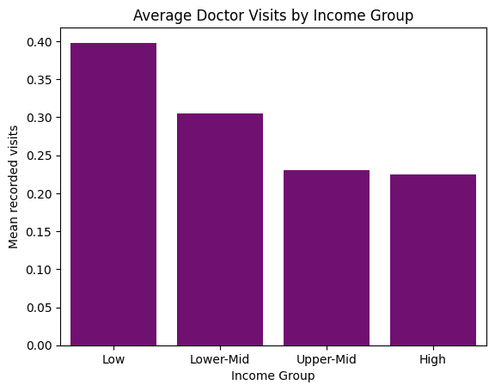
RESULTS
This chart compares average visits across four income groups.
The low-income group averages 0.40 visits, compared with 0.22 for the high-income group.
Visits fall as income rises, and the top two groups are almost the same.
Lower-income people visit more, again partly because they report more illness.

Slide 13

RESULTS
This chart compares the average number of visits for women and men.
Women average 0.36 visits and men average 0.24.
Women therefore visit about 53% more than men.
Both genders have a median of 0 visits, so most people in both groups did not visit.

Slide 14
Thank you
GITHUB DEMO LINK
https://github.com/snowlindhanusha/Healthcare-Analytics-for-Doctor-Visits/
.
.

